Slide 1
Aerodynamic Design of a Fowler Flap for a Hybrid Laminar Flow Control Airfoil
Holenarsipura, Shrinidhi, 06/05/2025
Advisor,
Dr.-Ing Stanislav Karpuk

Slide 2
Contents
Tasks
Objective
Introduction
Methodology
Trade studies
Results
Summary
Future work

Slide 3
Contents
Tasks
Objective
Introduction
Methodology
Trade studies
Results
Summary
Future work

Slide 4
Tasks
Define and modify an existing design methodology for a rapid CFD analysis of airfoils.
Perform parametric studies of a Fowler flap.
Obtain a new design and compare key aerodynamic characteristics between the original and the final configurations.
Objective
Maximize lift for takeoff (15°) and landing (30°) flap settings.

Slide 5
Contents
Tasks
Objective
Introduction
Methodology
Trade studies
Results
Summary
Future work

Slide 6
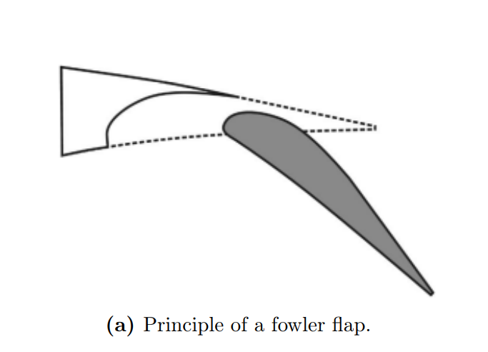
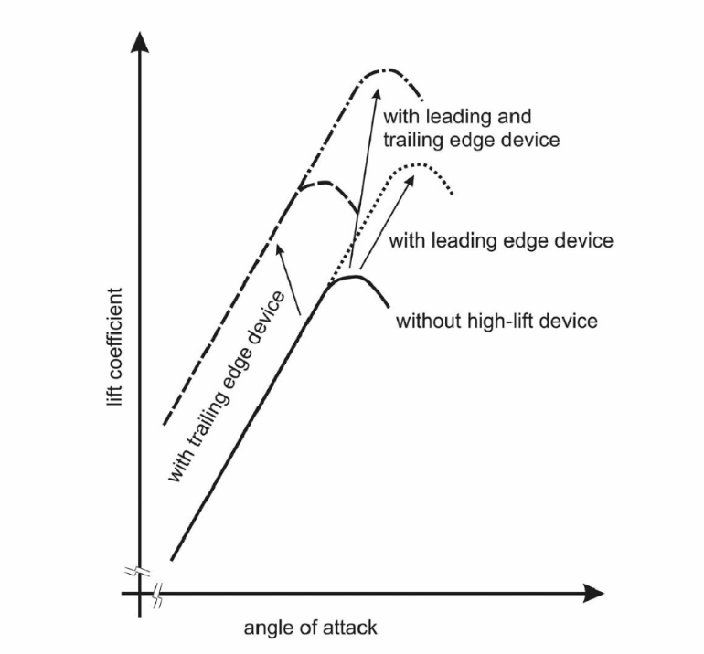
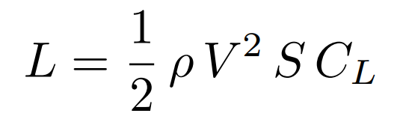
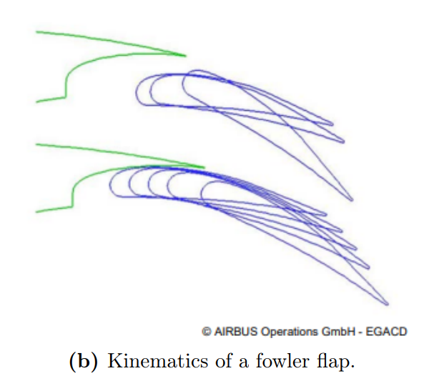
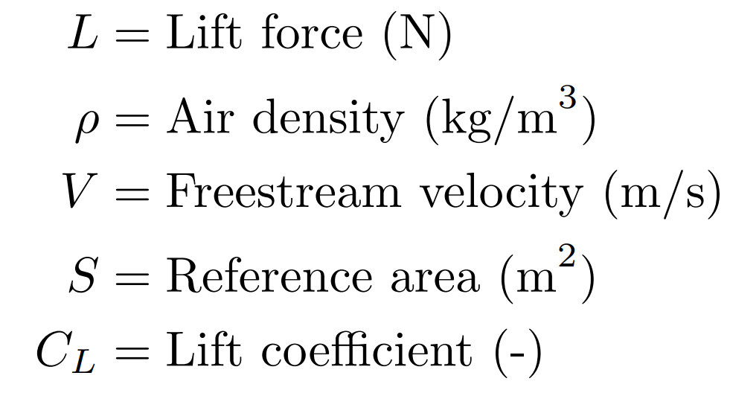
High-lift devices
Fig 1: Effect of high-lift devices
on the lift coefficient (C_{L}) and the angle of attack (α) [1].
Fig 2: Mechanism of the Fowler flap
[1], [2].

Slide 7
Contents
Tasks
Objective
Introduction
Methodology
Trade studies
Results
Summary
Future work

Slide 8
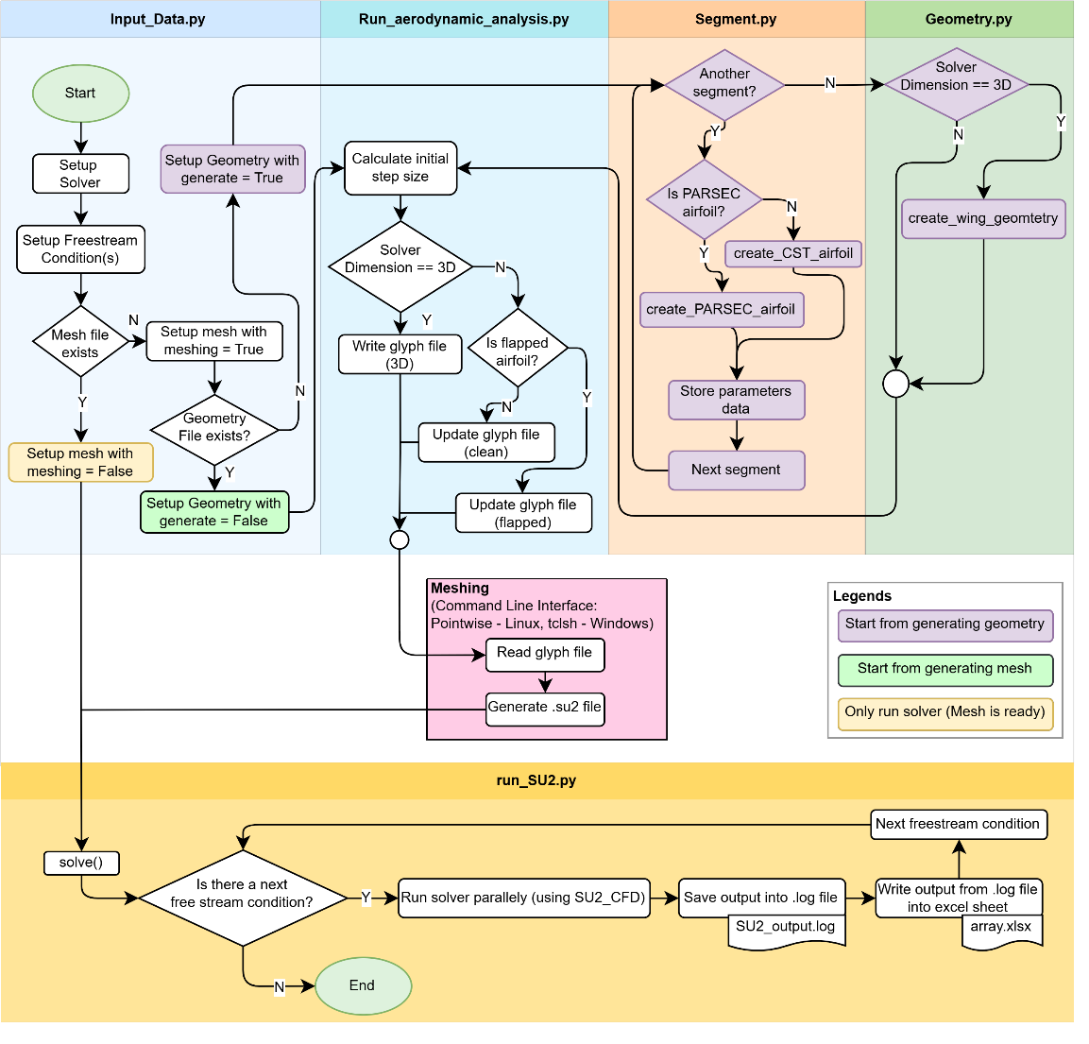
PyAeroSweep framework
Python
Fidelity Pointwise
Fig 6: PyAeroSweep
Framework.
SU2_{CODE}

Slide 9
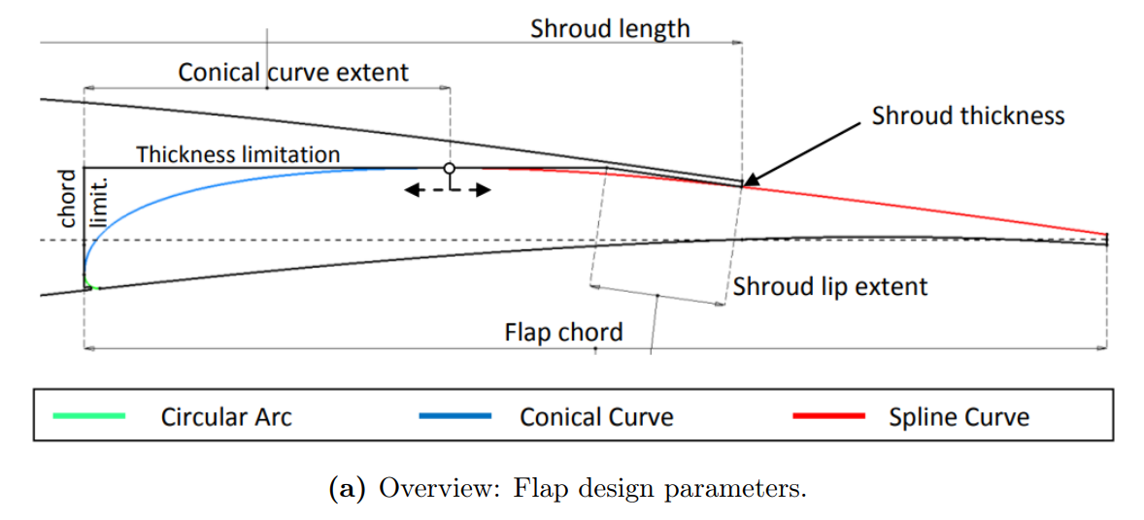
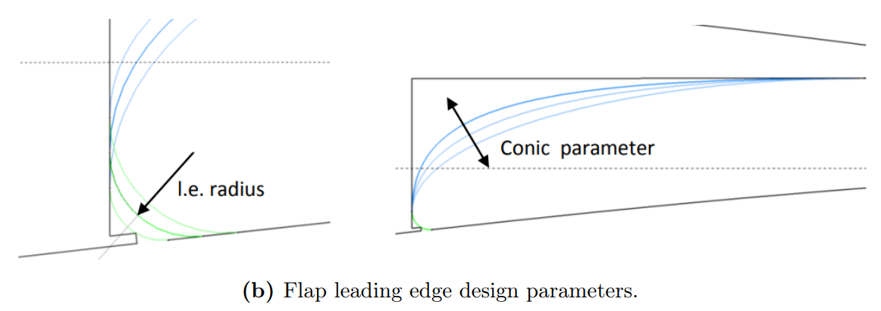
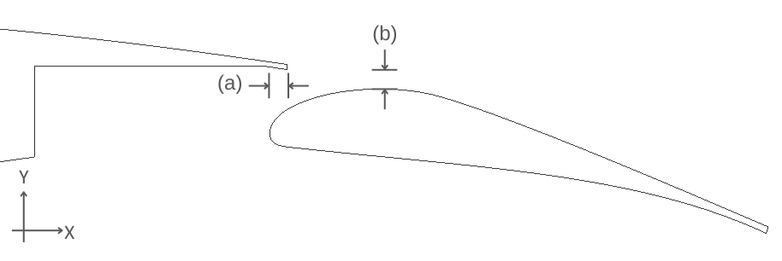
Geometry definition
Fig 3: Key flap geometry definitions [3].
Fig 4: (a) Horizontal overlap x_gap and (b) Vertical gap y_gap definition.

Slide 10
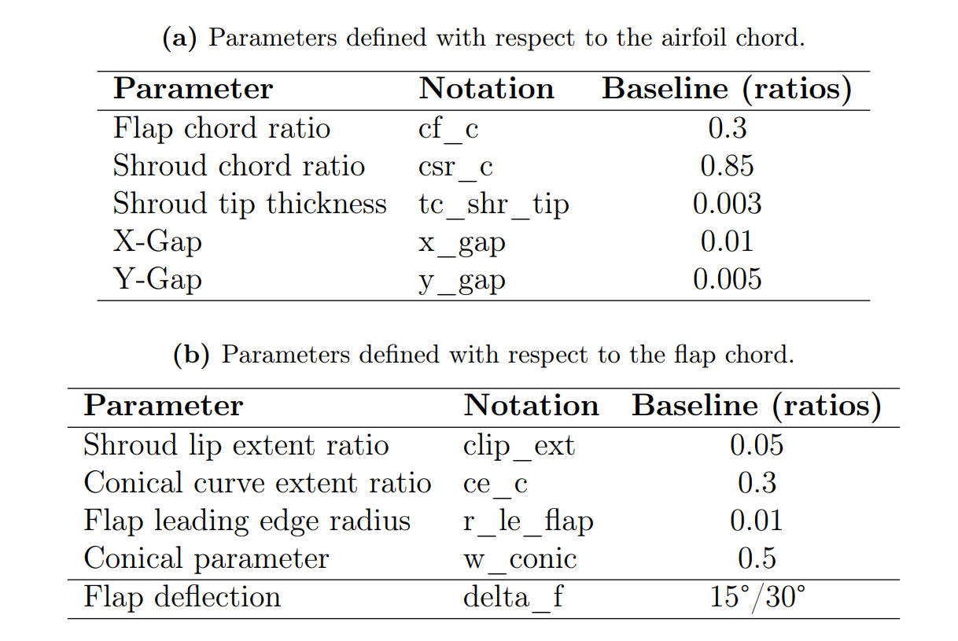
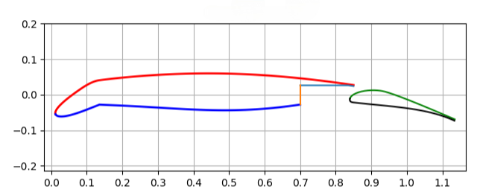
Geometric parameters – baseline flap
Fig 5: PARSEC airfoil.
15° droop nose
15°/30° flap deflection
Table 1: Geometric parameters for the baseline flap design.

Slide 11
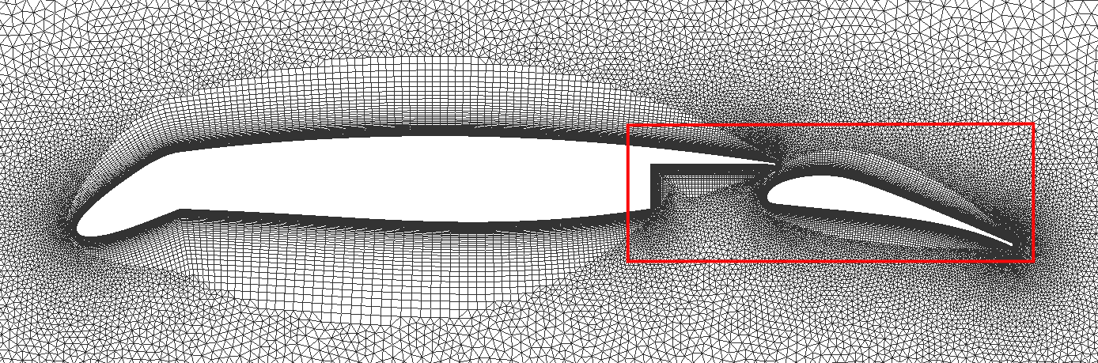
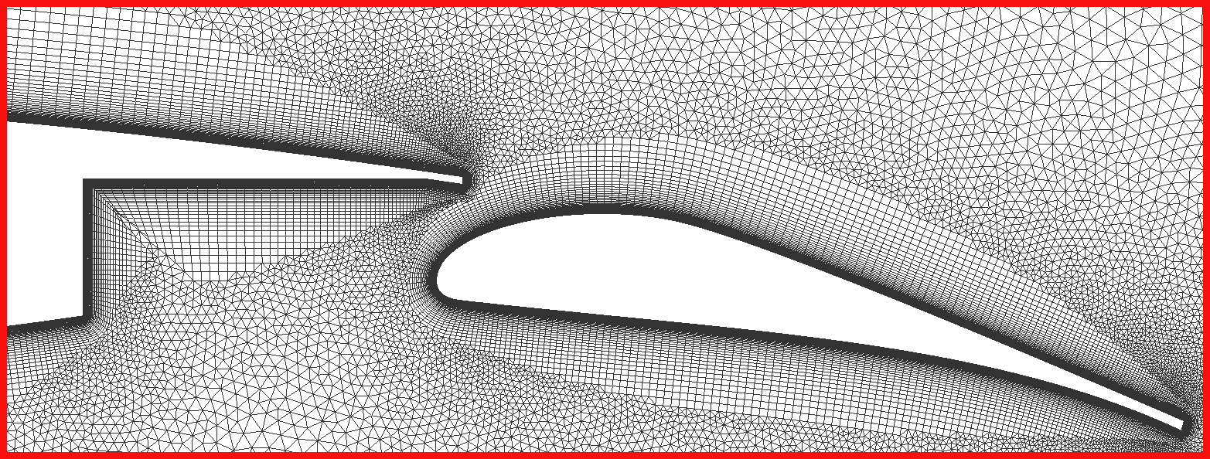
Mesh generation – Fidelity Pointwise
Fig 7: Computational mesh around the HLFC airfoil.
Fig 8: Detailed view of the computational mesh around the Fowler flap.

Slide 12
CFD solver – SU2
Steady-state Reynolds-Averaged Navier-Stoken (RANS) equations.
k −ω SST (Shear Stress Transport) – Two equation turbulence model.
Better handling of adverse pressure gradients and flow separation.
Enhanced near-wall resolution.
k: Turbulent kinetic energy (m²/s²)
ω: Specific Rate of Dissipation (1/s)

Slide 13
Contents
Tasks
Objective
Introduction
Methodology
Trade studies
Results
Summary
Future work

Slide 14
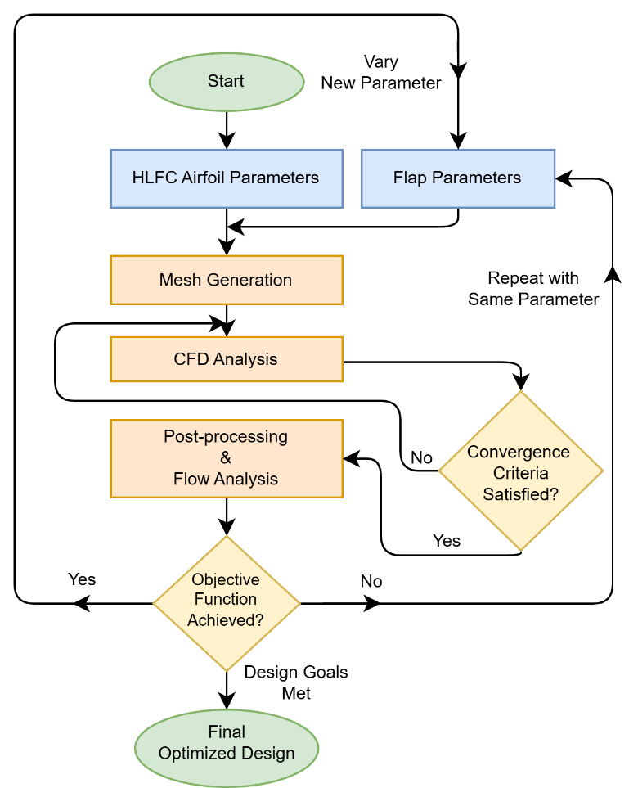
Optimization strategy
OAT One-At-A-Time Optimization
Fig 9: Fowler flap design optimization strategy.

Slide 15
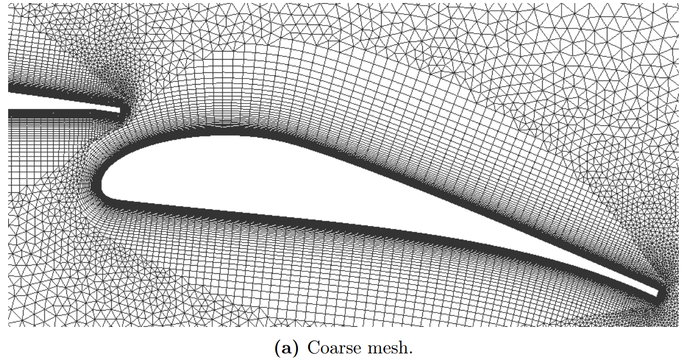
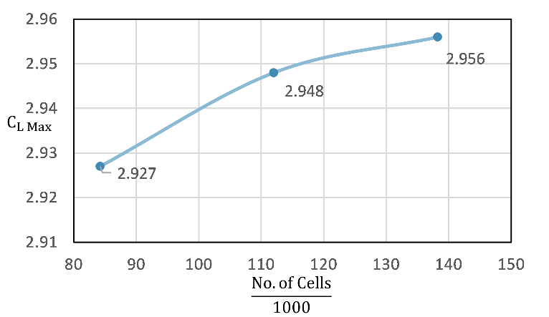
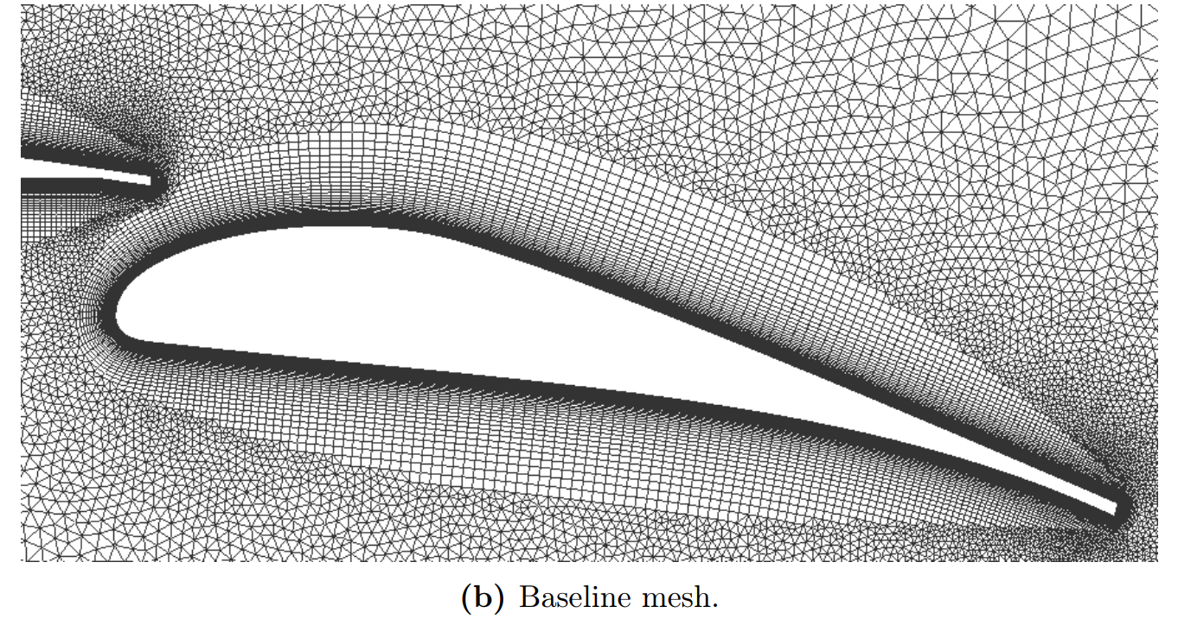
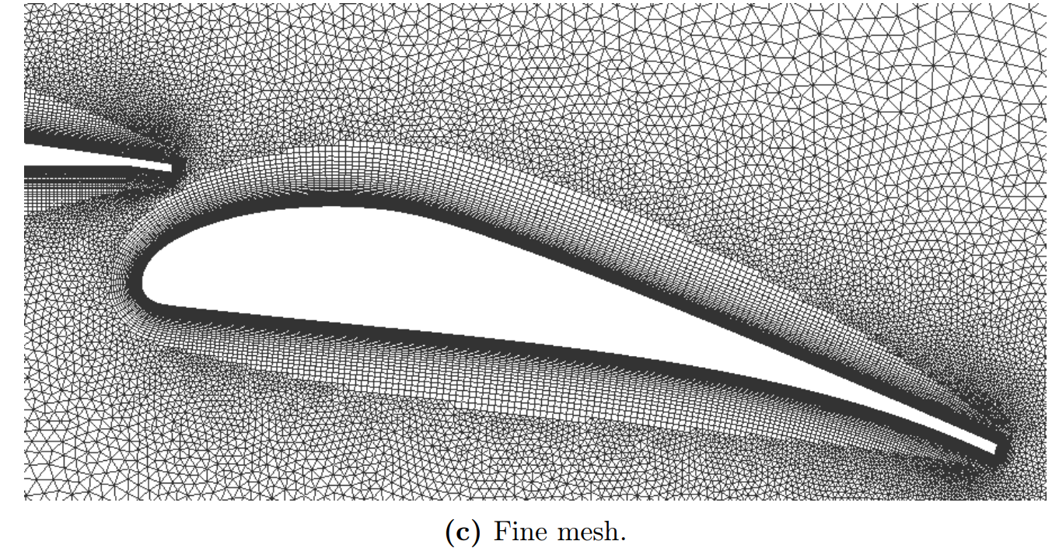
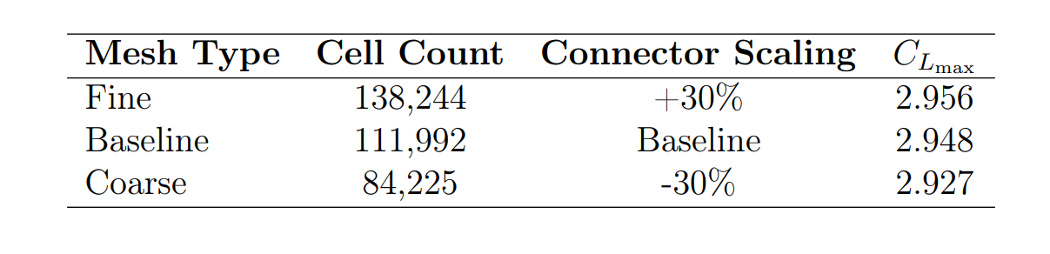
Mesh sensitivity study
Fig 11: Effect of mesh refinement on grid resolution.
Fig 10: Impact of mesh refinement on maximum lift coefficient (C_{Lmax} ).
+0.27%
+0.71%
Table 2: Results of the mesh sensitivity study.

Slide 16
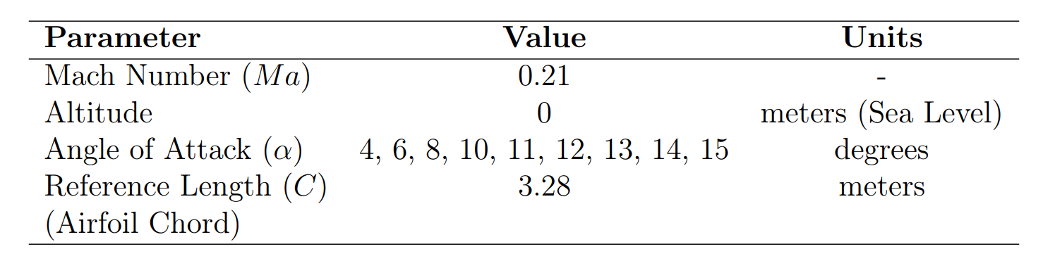
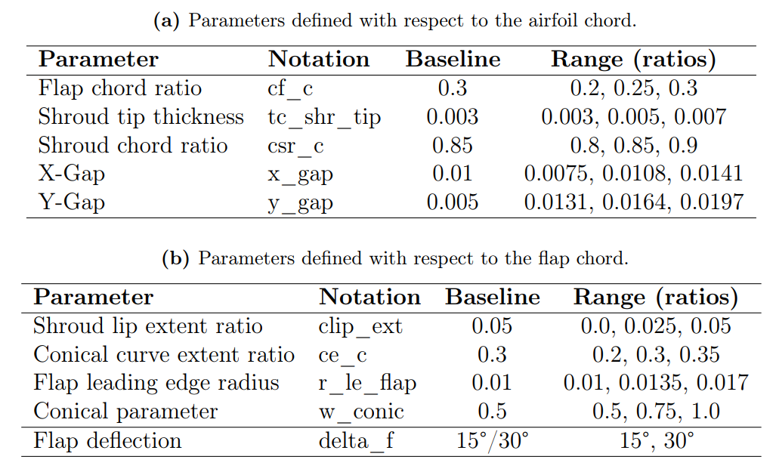
Parameter sensitivity study
Table 4: Range of geometric parameters for the to-be optimized flap design.
Table 3: Simulation freestream conditions and reference length (airfoil chord).

Slide 17
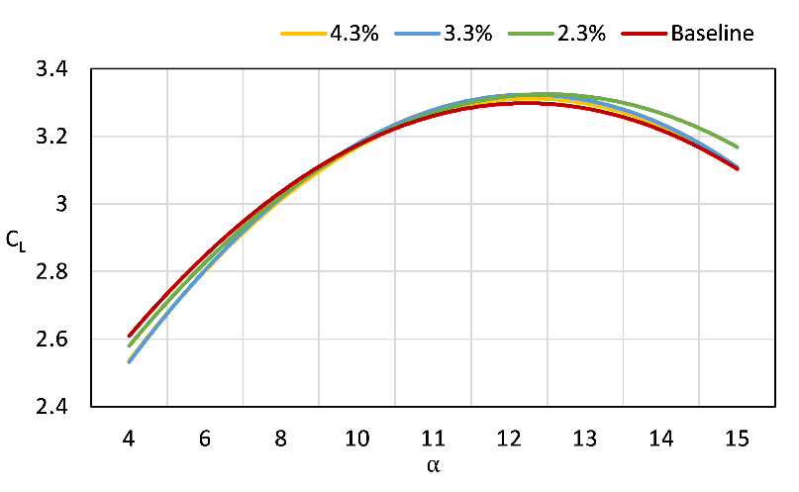
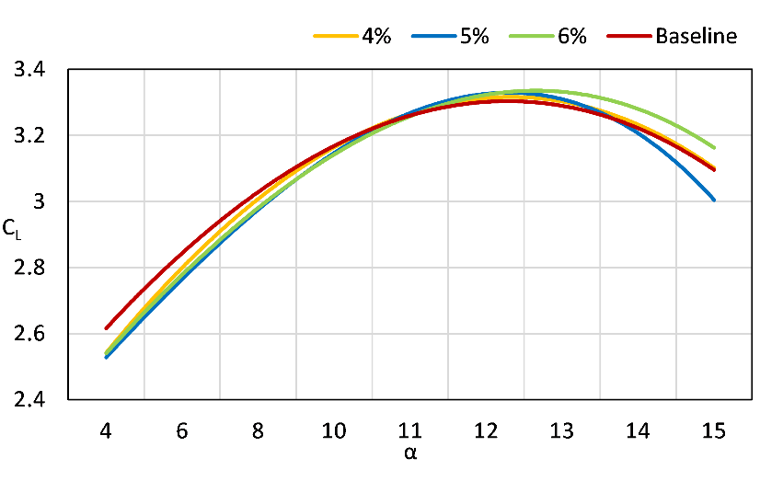
Effect of variation of x_gap & y_gap on C_{D} and C_{L} varied across α:
Figure 12: Effect of variation of x_gap on C_{L} vs α, with y_gap fixed at 4.0%
of the airfoil chord.
Figure 13: Effect of variation of y_gap on CL vs α, with x_gap fixed at 4.3% of the airfoil chord.
Baseline:
x_gap 3.0 % y_gap 1.5 %

Slide 18
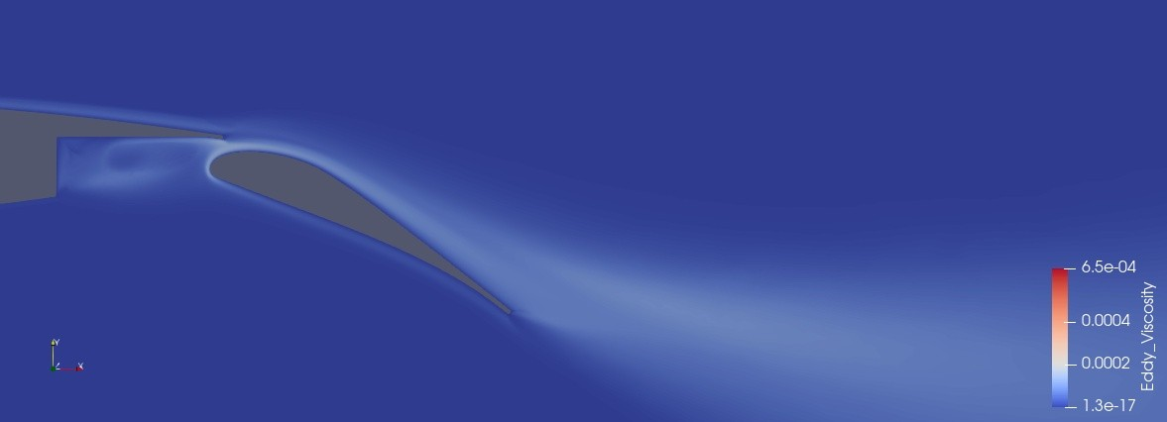
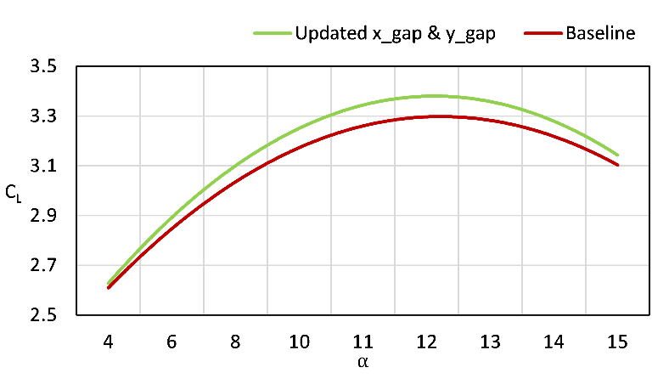
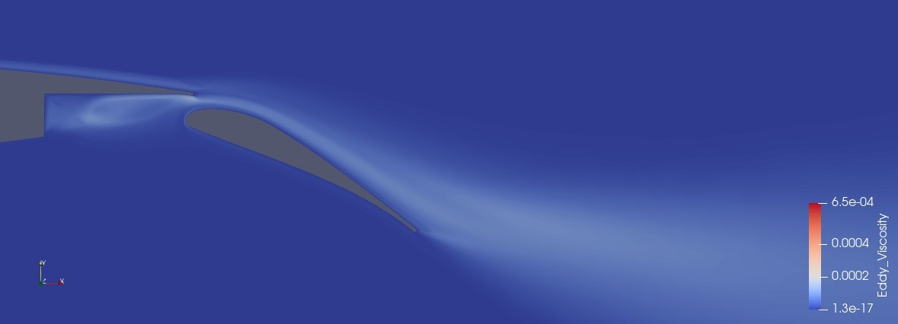
Updated x_gap & y_gap
Fig 18: Baseline configuration
(x_gap at 3.0% & y_gap at 1.5% of the airfoil chord).
Figure 17: Comparison of baseline and updated configuration
(x_gap at 2.3% and y_gap 6.0%).
2.43 % increase in C_{Lmax}
30° flap deflection
4° Angle of attack
Fig 19: Updated configuration
(x_gap at 2.3% & y_gap at 6.0% of the airfoil chord).

Slide 19
Contents
Tasks
Objective
Introduction
Methodology
Trade studies
Results
Summary
Future work

Slide 20
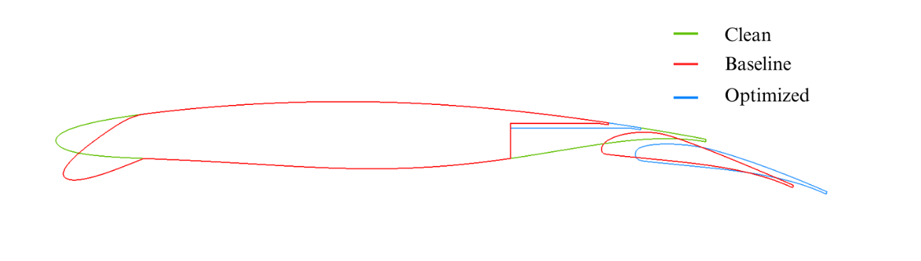
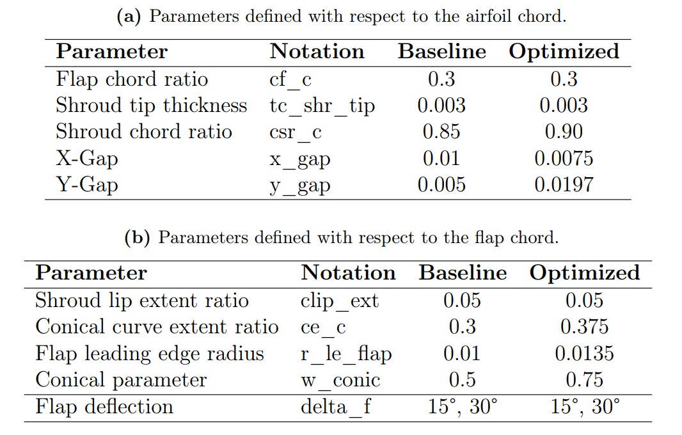
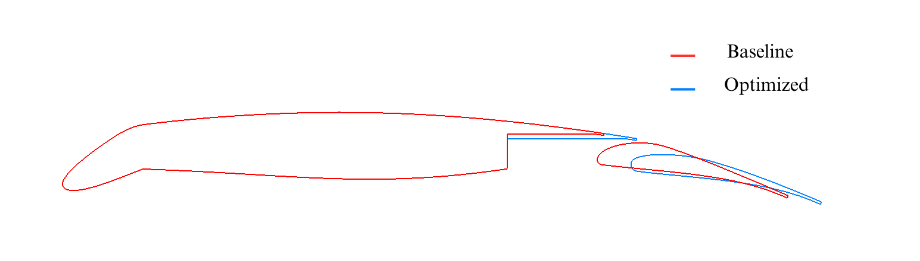
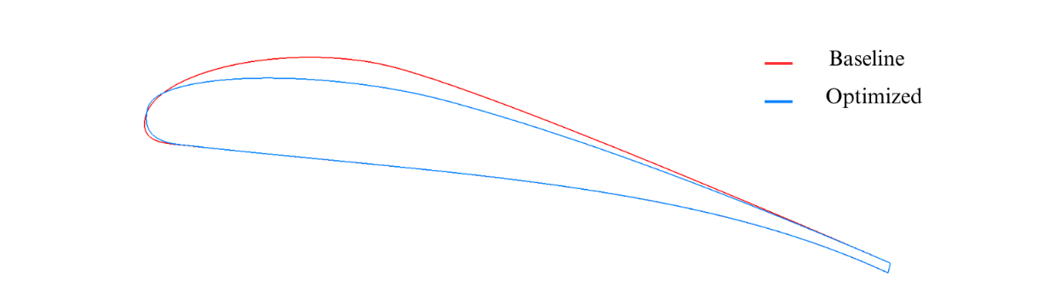
Results
Table 5: Baseline and optimized flap design parameters (in ratios).
Fig 20: Comparison of baseline and optimized airfoil and flap geometric profiles (all parameters optimized).

Slide 21
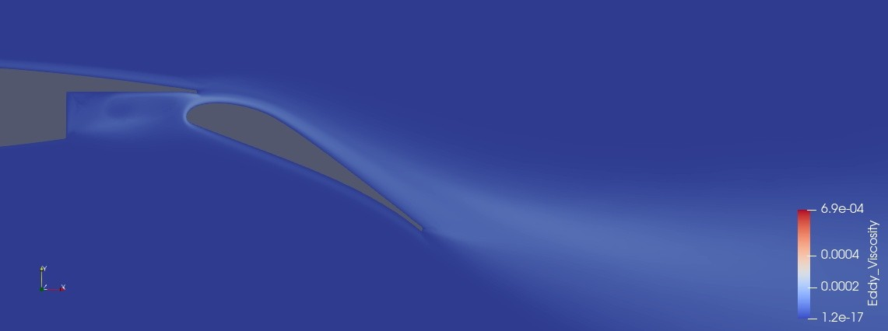
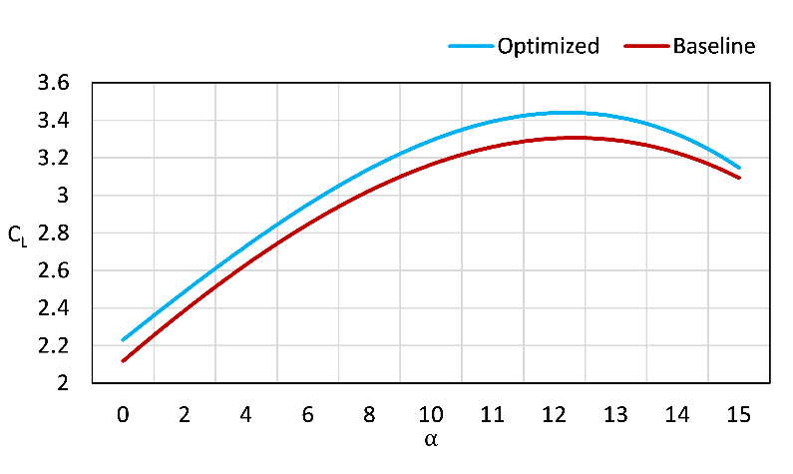
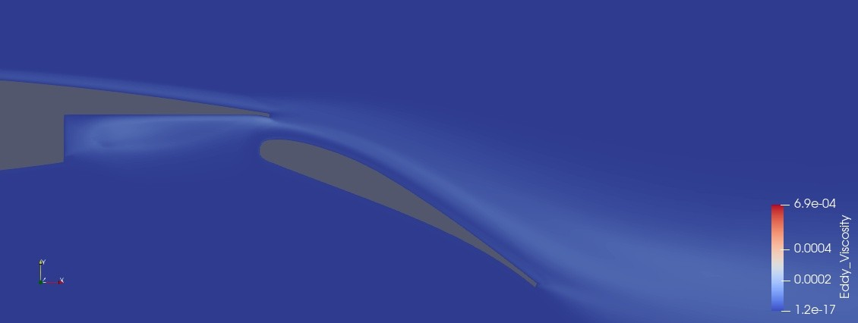
Aerodynamic performance at 30-degree flap deflection
Fig 22: Eddy viscosity: Baseline configuration.
Figure 21: Comparison of baseline and optimized configuration (C_{L} vs α).
4.56 % increase in
C_{Lmax}
30° flap deflection
4° Angle of attack
Fig 23: Eddy viscosity: Optimized configuration
(all parameters optimized).

Slide 22
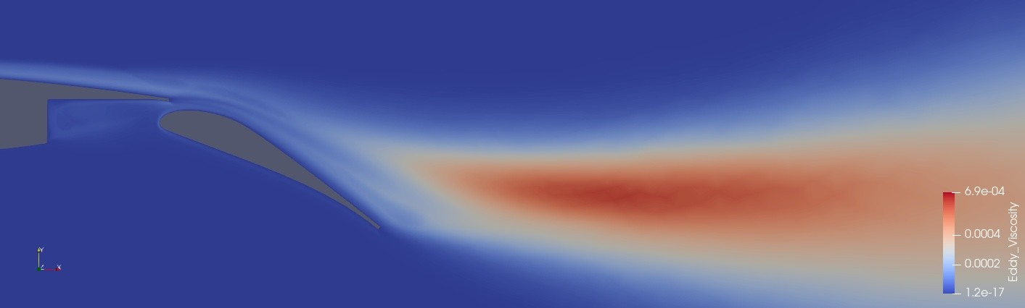
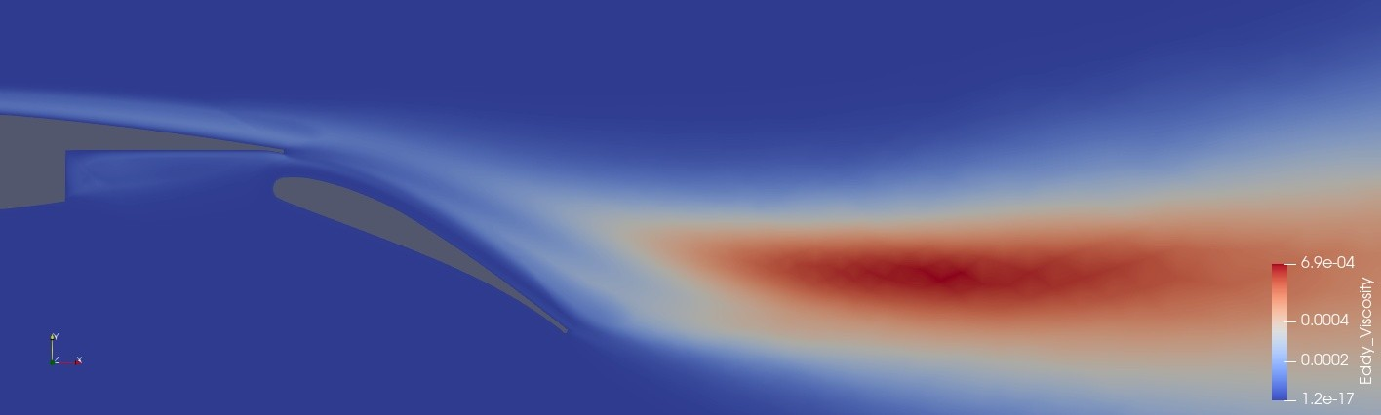
Aerodynamic performance at 30-degree flap deflection
Fig 25: Eddy viscosity: Baseline configuration.
Figure 21: Comparison of baseline and optimized configuration (C_{L} vs α).
4.56 % increase in
C_{Lmax}
30° flap deflection
13° Angle of attack
Fig 26: Eddy viscosity Optimized configuration
(all parameters optimized).

Slide 23
Contents
Tasks
Objective
Introduction
Methodology
Trade studies
Results
Summary
Future work

Slide 24
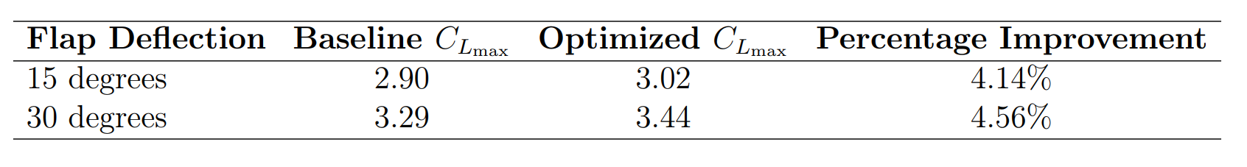
Summary
1000+ CFD runs, manually optimized and post-processed.
10 parameters varied.
Tested for:
15° flap deflection.
30° flap deflection.
Table 6: Summary of maximum lift coefficient (C_{Lmax}) improvements.

Slide 25
Contents
Tasks
Objective
Introduction
Methodology
Trade studies
Results
Summary
Future work

Slide 26
Future work
Unsteady Reynolds-Averaged Navier-Stokes (URANS).
Implementing:
Surrogate-Based Optimization.
Automatic Optimization Algorithms.

Slide 27
References
[1] Jochen Wild. High-lift aerodynamics. CRC Press, 2022
[2] Henning Strüber. ‘The aerodynamic design of the A350 XWB-900 high lift system’. In: 29th international congress of the aeronautical sciences. International Council of the Aeronautical Sciences. 2014.
[3] Mauro Minervino, Pierluigi Iannelli and D. Quagliarella. ‘3D Flap Design using Navier- Stokes Equations and Evolutionary Optimization Techniques on an Industrial Platform’. In: Sept. 2011. doi: 10.13140/2.1.2211.0083.

Slide 28

Thank you for listening.

Slide 29
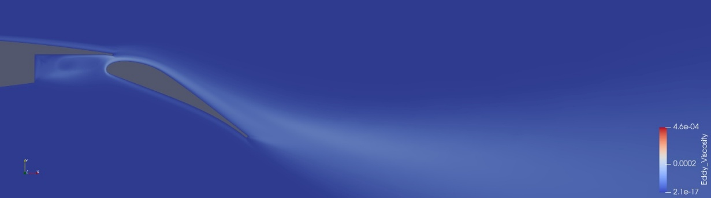
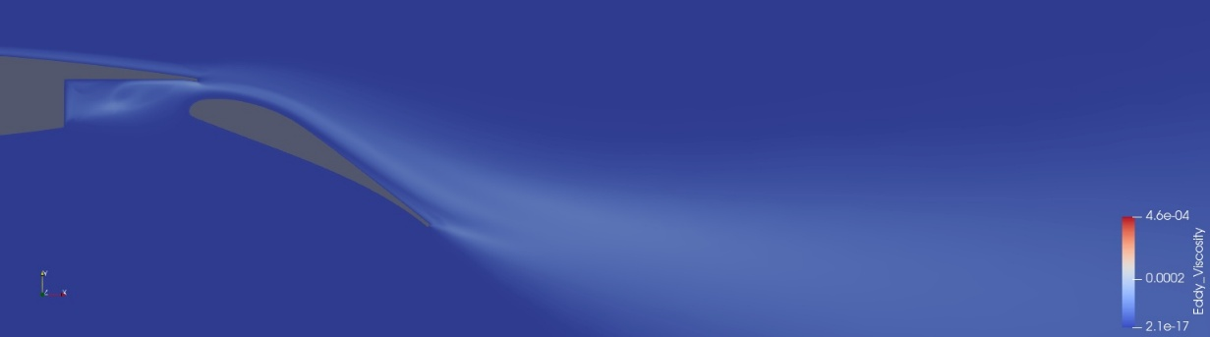
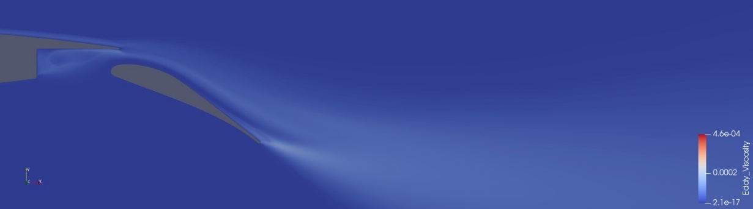
Eddy Viscosity
Fig 14: Baseline configuration
(x_gap at 3.0% & y_gap at 1.5% of the airfoil chord).
Fig 15: Optimized configuration (x_gap at 2.3% & y_gap at 4.0% of the airfoil chord).
Fig 16: Optimized configuration (x_gap at 4.3% & y_gap at 6.0% of the airfoil chord).
30° flap deflection
4° Angle of attack

Slide 30
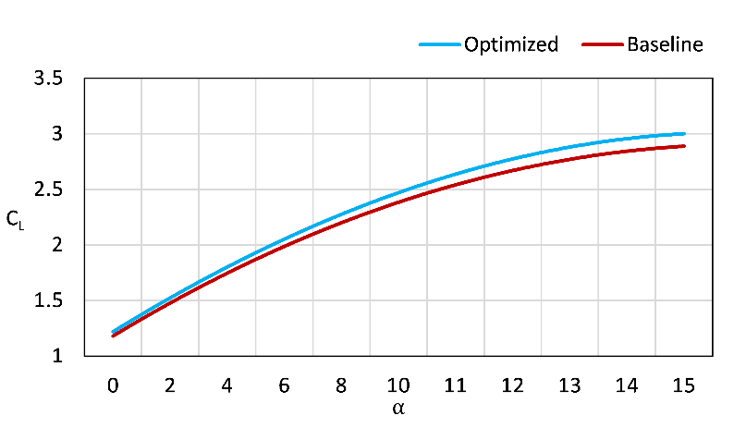
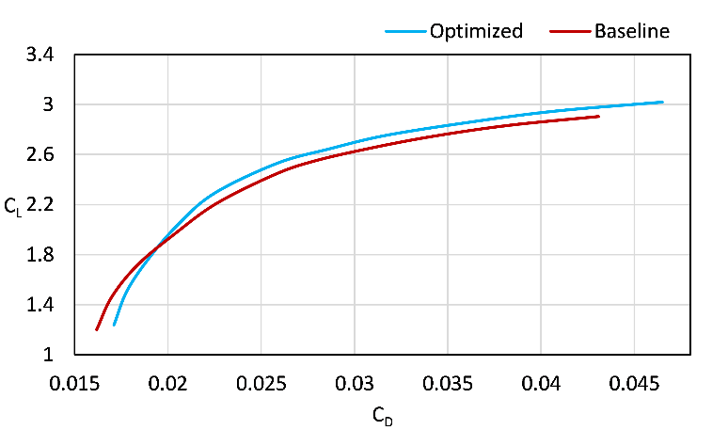
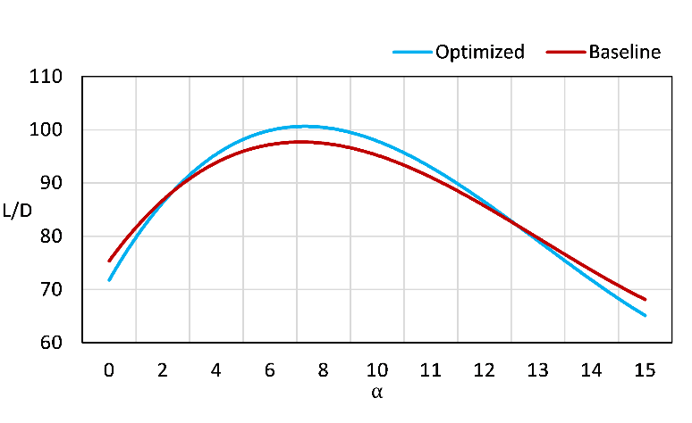
Aerodynamic performance at 15-degree flap deflection

Slide 31
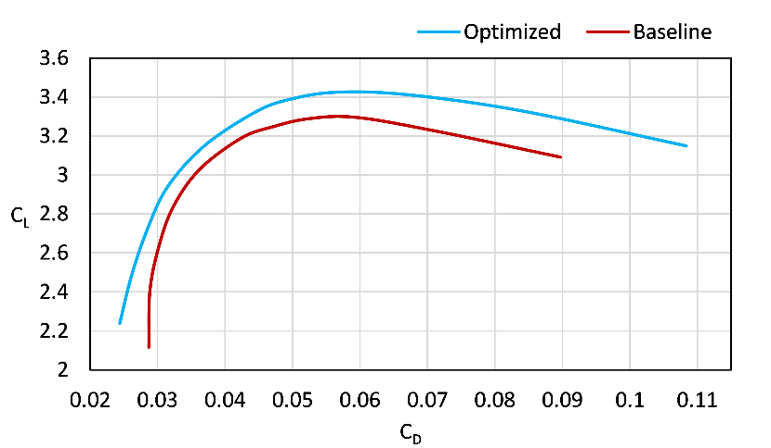
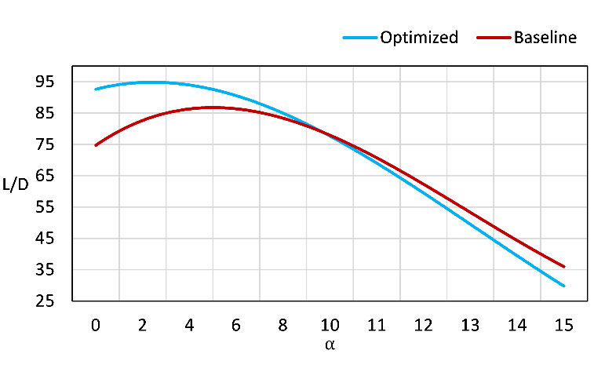
Aerodynamic performance at 30-degree flap deflection

